Slide 1
A Robust Bin-Packing Approach for ESS Assembly Line Scheduling under Human-Machine Uncertainty

Slide 2






Problem Context & Motivation
Station A
Station B
Automated
Busbar Assembly
Manual Harness
Alignment & Riveting
Intermediate
Steps
…
(e.g., Welding,
Inspection,
Testing, etc.)
Output
Completed
ESS Product
Stage 1
(Upstream
Supply)
Expert
Novice
≈140 micro-stops / month
100 minutes downtime per occurrence
50% Speed Gap
Between workers

Slide 3



Problem Context & Motivation
Ideal Deterministic Schedule - ESS assembly line stage 2
10 Jobs in 8 Hours (Ideal)
Job 1
Job 2
Job 3
Job 4
Job 5
Job 6
Job 7
Job 8
Job 9
Job 10
Station A (Manual)
Station B (Automated)
1 Bin = 1 Working Day (8-Hour Shift)
Stochastic Disruptions
Actual Realization: Capacity Gridlock & Loss
Mechanical
halts
Expert speed
variability
Job 1
Job 2
Job 3
Job 4
Job 5
Job 6
Job 7
Job 8
Job 9
Job 10
4 planned jobs
uncompleted
Aggregated Stochastic Jitter
CAPACITY
LOSS
8-Hour Shift

Slide 4
How can we create a schedule that is robust enough to absorb these red spikes without creating gridlock?

Slide 5






Mathematical Internalization & Budgeting
Internalizing Aggregated Risks into “Robust Items”
p’_{j} = 𝜇_{A, j} + 𝜇_{B, j} + k $\sqrt{{\text{σ}}_{A, j }^{\text{2}}+{\text{σ}}_{B, j}^{\text{2}} }$
Mathematical Abstraction
Robust Item Volume Formula
Station A:
Manual Harness Alignment (H)
Station B:
Automated
Riveting (M)
INTERNALIZING
Ideal Job
Station A 𝜇
Station B 𝜇
$\text{H}\text{uman} \text{Variability} \text{σ}$_{A}
Machine
$$\text{M}\text{icro}\text{−}\text{stops}$$
$\text{σ}\text{B}$
Nominal Process Time (𝜇_{j})
The k-factor Budget
Station A:
Manual Harness Alignment (H)
Station B:
Automated
Riveting (M)
1
Station A
Station B
K-set
k controls the size of the uncertainty set
for each job.
Low k = Compact Set
High k = Enveloped Set
Optimal k = balancing risk and cost, found via the simulation
2
8-Hour Shift
3
Aggregated Stochastic Jitter (kσ_{j})
Robust Item Definition (p′_{j})
4

Slide 6















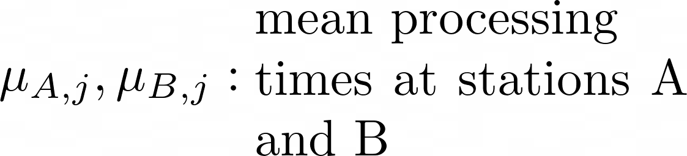


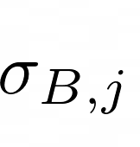
Bin-Packing Formulation – Model Ingredients
Sets and Indices
Decision Variables
Set of jobs
Set of bins/days
Overtime mins on day t
Job j on day t
at position p
Overtime activation indicator
Positions per day
Parameters
Standard Capacity per bin
Robustness Factor
Overtime Cost/min
Overtime Activation Cost
Processing time at position p of day t
Completion time of position p in day t
Mean Processing time of job at Station A/B
Variability from Station A/B

Slide 7
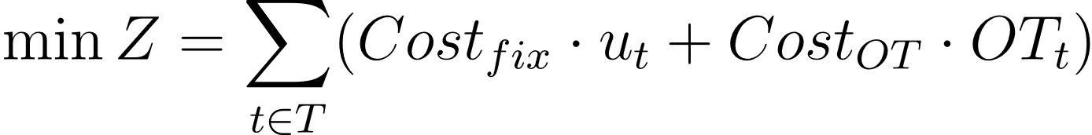
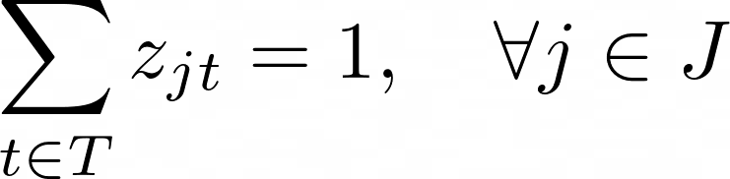
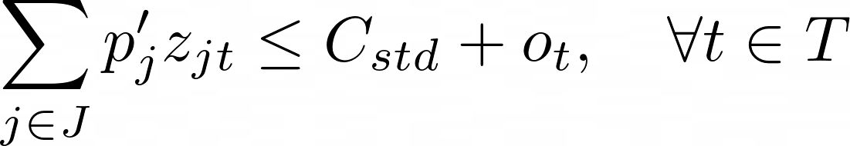
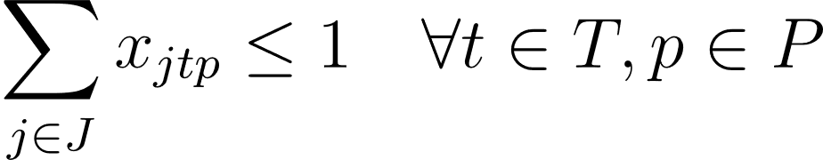

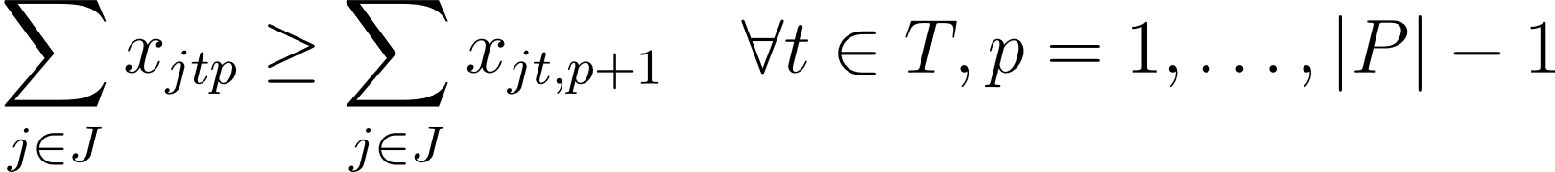
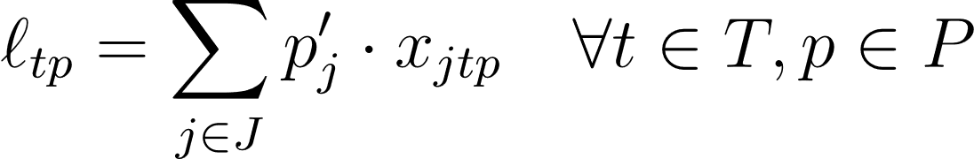
Bin-Packing Formulation
Objective Function
(1) Full Assignment Constraint
(5) Robust Daily Capacity Constraint
(2) Single Job per Slot
(6) Overtime Activation Logic (Big-M)
(3) Sequential Slot Filling
(7) Binary & Domain Constraints
(4) Sequential Slot Filling

Slide 8
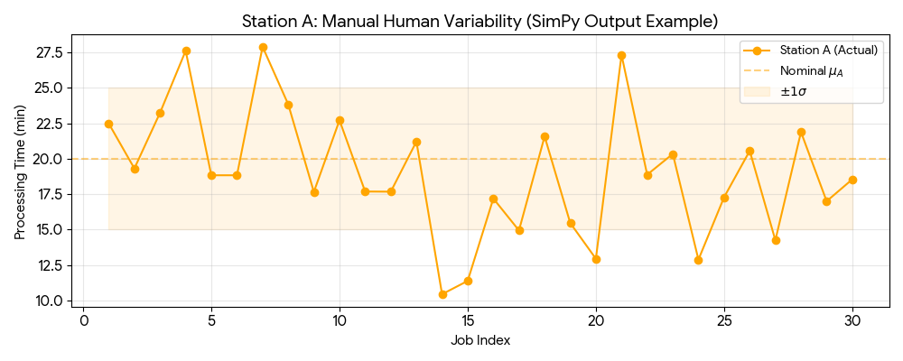
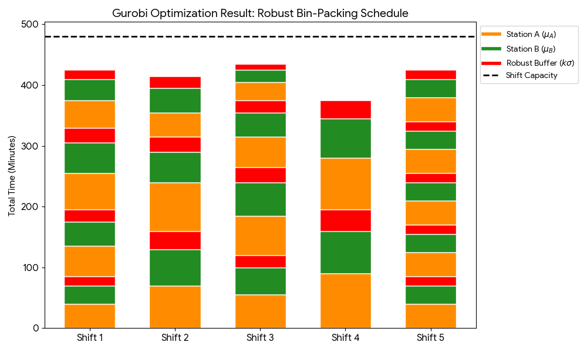
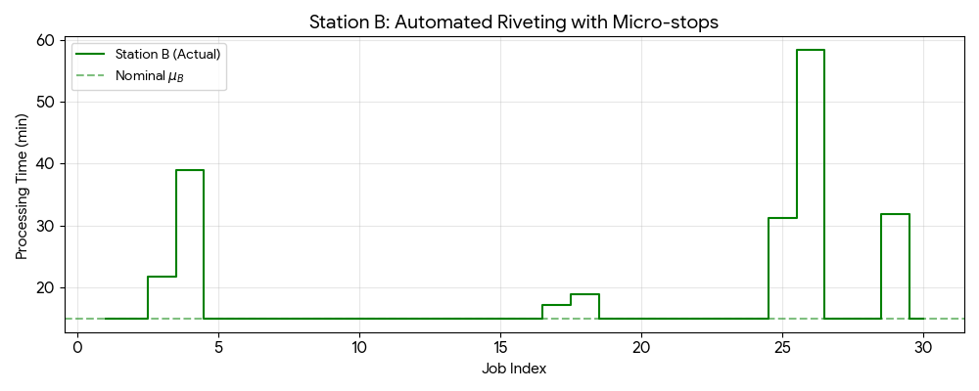
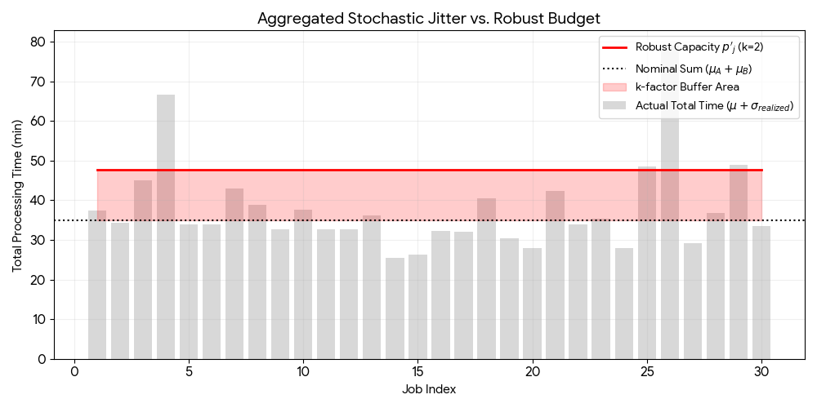


Verification via Gurobi-SimPy Integration
The Planner (Gurobi)
Robust Optimization
The Reality (SimPy)
Stochastic Simulation

